Slide 1

Note: The data and information in this document is reflective of a hypothetical situation and client. This document is to be used for KPMG Virtual Internship purposes only.
Sprocket Central Pty Ltd
Data analytics approach
[Division Name] - [Engagement Manager], [Senior Consultant], [Junior Consultant]

Slide 2
Note: The data and information in this document is reflective of a hypothetical situation and client. This document is to be used for KPMG Virtual Internship purposes only.
Agenda
Introduction
Data Exploration
Model Development
Interpretation

Slide 3
Note: The data and information in this document is reflective of a hypothetical situation and client. This document is to be used for KPMG Virtual Internship purposes only.
Introduction
New Customer Analysis
Age distributions
Job industry category
Customer’s State
Wealth segment
Number of bike purchases in 3 years
Product size of previous purchase
Most purchased and most profitable brand

Slide 4
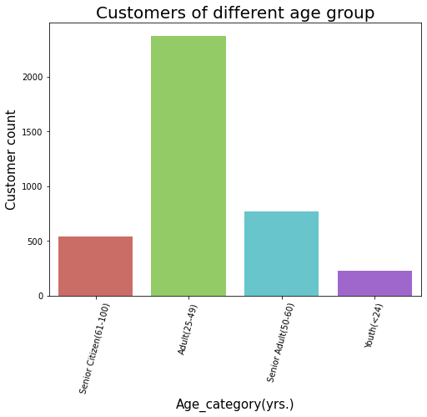
Note: The data and information in this document is reflective of a hypothetical situation and client. This document is to be used for KPMG Virtual Internship purposes only.
Data Exploration
Customer Age Distribution
As we can see, most of our new customers are between 25 to 49 years old.
Number of customers from 48 to 59 years old has big drops on percentages.
There is a slightly increase in number of customers over 59 years old in term of percentages
It looks like the percentages of customers under 25 years old not really change.

Slide 5
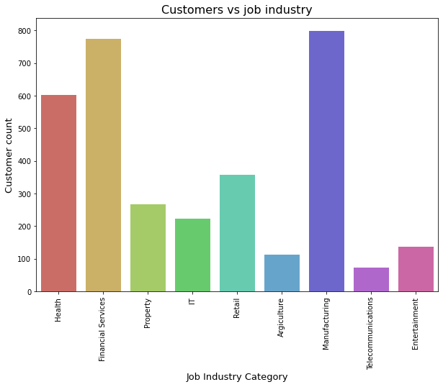
Note: The data and information in this document is reflective of a hypothetical situation and client. This document is to be used for KPMG Virtual Internship purposes only.
Model Development
Job industry category
Most of the new customers belong to Manufacturing industry.
Focus to attract health or financial services industry.
There is very lesser chance of a new customer from Agriculture and Telecommunication industry.

Slide 6
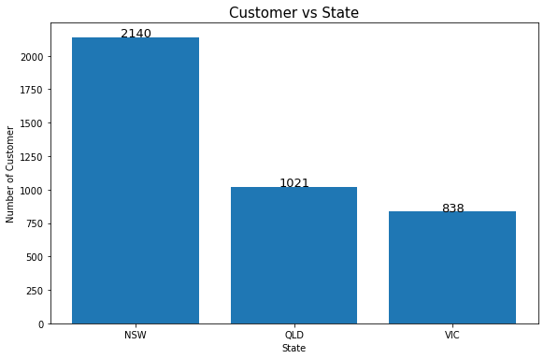
Note: The data and information in this document is reflective of a hypothetical situation and client. This document is to be used for KPMG Virtual Internship purposes only.
Interpretation
Customer’s State
Most of the new customers are from New South Wales.
We should focus on getting more customers from New South Wales state.

Slide 7
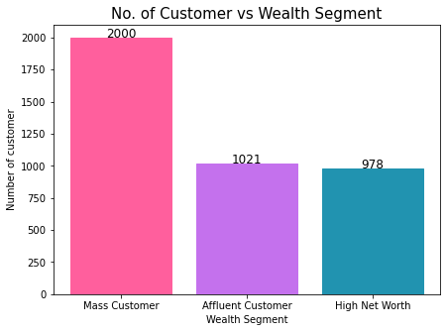
Note: The data and information in this document is reflective of a hypothetical situation and client. This document is to be used for KPMG Virtual Internship purposes only.
Interpretation
Wealth segment
In all ages, the number of Mass Customers is the highest so we should focus on this class of society.
After that, we should focus on Affluent Customer.
There is tiny difference in high net worth and affluent customers, so we should focus on both equally.

Slide 8
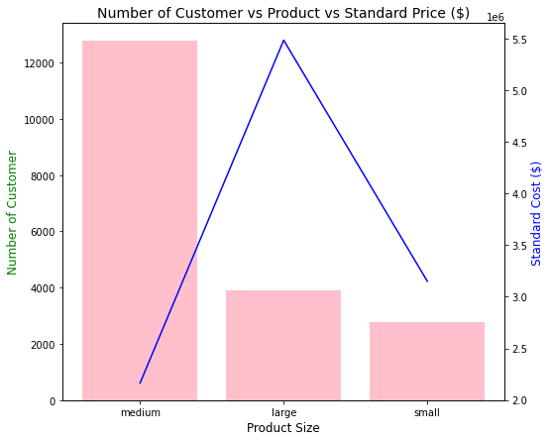
Note: The data and information in this document is reflective of a hypothetical situation and client. This document is to be used for KPMG Virtual Internship purposes only.
Interpretation
Product size of previous purchases
Large number of customers purchased medium size bikes.
Focus on customers resident of New South Wales purchasing medium sized products.
Also focus on cost of medium size product because one of the main reason of their highest selling is low pricing.

Slide 9
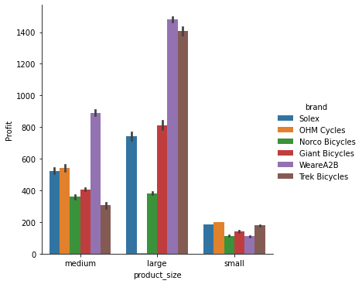
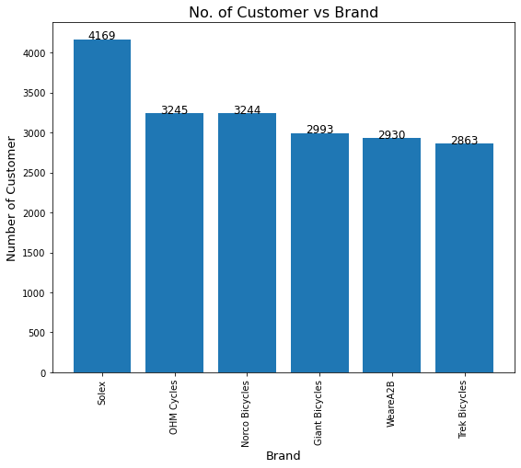
Note: The data and information in this document is reflective of a hypothetical situation and client. This document is to be used for KPMG Virtual Internship purposes only.
Interpretation
Most purchased and most profitable brand
"Solex" brand bicycles the ones most purchased by the new customers.
Also all product size of trek cycles are profitable.

Slide 10
Note: The data and information in this document is reflective of a hypothetical situation and client. This document is to be used for KPMG Virtual Internship purposes only.
Appendix

Slide 11
Note: The data and information in this document is reflective of a hypothetical situation and client. This document is to be used for KPMG Virtual Internship purposes only.
Appendix
https://github.com/gupta-kartikeya/KPMG-Virtual-Internship

